Slide 1
Machine Learning with Python
By: Er. Aayush Adhikari

Slide 2
Introduction
Machine learning (ML) is defined as a discipline of artificial intelligence (AI) that provides machines the ability to automatically learn from data and past experiences to identify patterns and make predictions with minimal human intervention.
Machine learning derives insightful information from large volumes of data by leveraging algorithms to identify patterns and learn in an iterative process. ML algorithms use computation methods to learn directly from data instead of relying on any predetermined equation that may serve as a model.

Slide 3
Supervised Learning
Trained using labeled data.
Predicts the output
Models take direct feedback to check whether it predict the correct output.
It includes various algorithms like Regression, Support Vector Machine, Decision Tree, Bayesian Logic, etc.
Unsupervised Learning
Trained using unlabeled data.
Finds hidden patterns of data.
The model does not take any feedback.
It includes various algorithms like Clustering, KNN, etc.

Slide 4
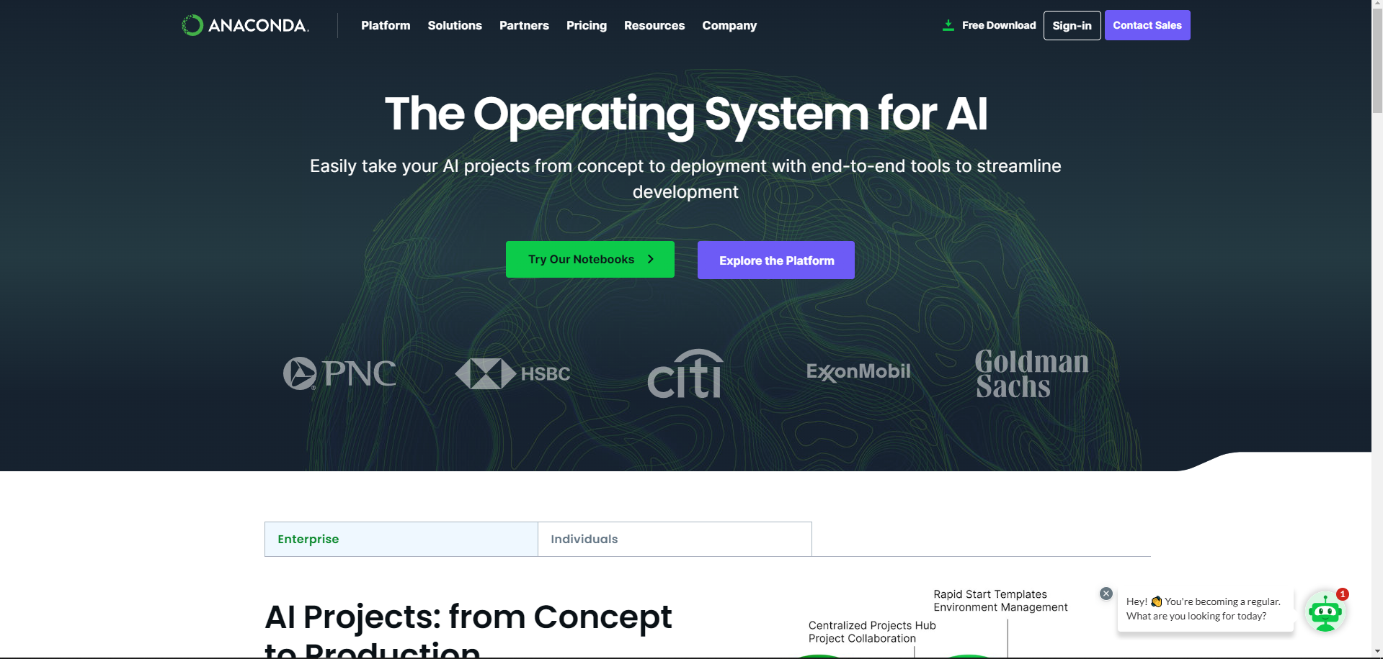

Slide 5


Slide 6
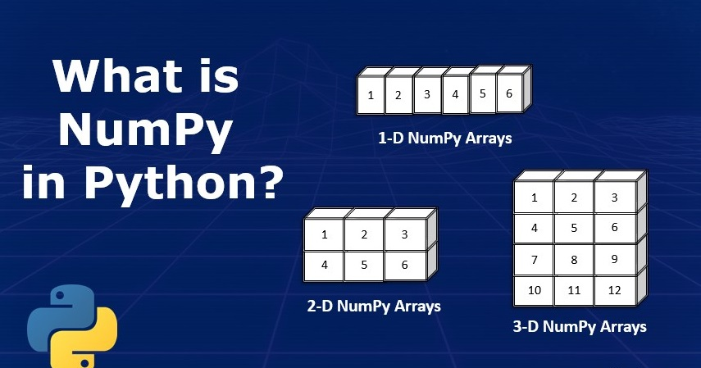

Slide 7
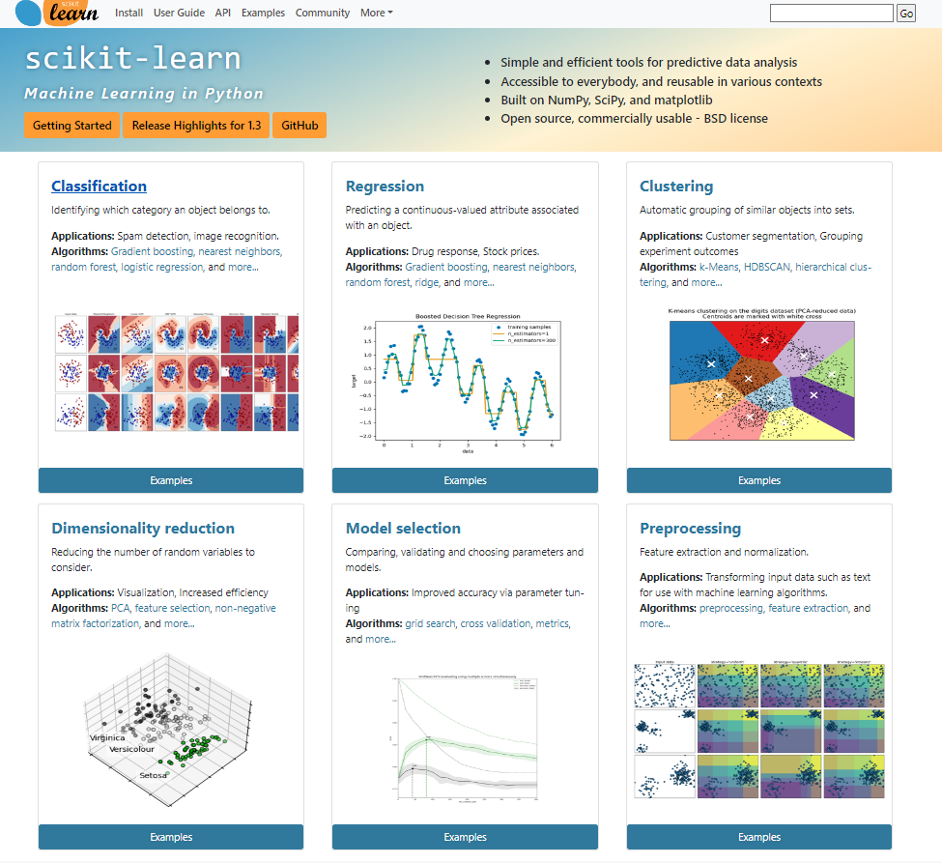

Slide 8
Other packages…
Pandas:
This is the most popular data manipulation package in Python.
Matplotlib:
This is a plotting library used for 2D graphics in Python programming language.
Seaborn:
Seaborn is a Python data visualization library based on Matplotlib. It provides a high-level interface for drawing attractive and informative statistical graphics.

Slide 9
Let’s code

